Slide 1
Priority Queues - Heaps

Slide 2
Motivating Example
3 jobs have been submitted to a printer in the order A, B, C.
Sizes: Job A – 100 pages
Job B – 10 pages
Job C -- 1 page
Average waiting time with FIFO service:
(100+110+111) / 3 = 107 time units
Average waiting time for shortest-job-first service:
(1+11+111) / 3 = 41 time units

Slide 3
Motivating Example
Need to have a queue which does insert and deletemin
Priority Queue!!

Slide 4
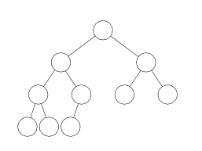
Heaps
Heaps are “almost complete binary trees”
-- All levels are full except possibly the lowest level.
If the lowest level is not full, then then nodes must be packed to the left.
Note: we define “complete tree” slightly different from the book.

Slide 5
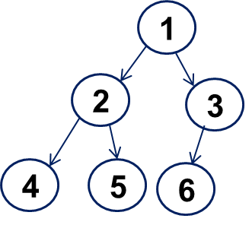
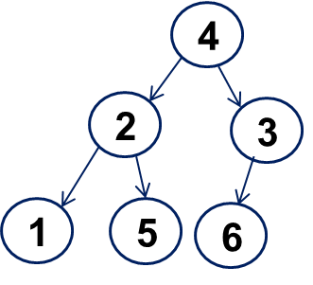
Coming back to Heap
Heap property: the value at each node is less than or equal to that of its descendants.
A heap
not a heap

Slide 6
Coming back to Heap
Heap property: the value at each node is less than or equal to that of its descendants.
1
4
2
5
2
5
4
1
3
6
3
6
A heap
not a heap

Slide 7
Heap
Heap supports the following operations efficiently
Locate the current minimum in O(1) time
Delete the current minimum in O(log N) time

Slide 8
Insertion
Add the new element to the lowest level
Restore the min-heap property if violated:
“bubble up”: if the parent of the element is larger than the element, then interchange the parent and child.

Slide 9
Insertion
2
2
6
Insert 5
6
8
8
9
7
11
9
7
11
5
2
6
5
9
7
11
8
Percolate up to maintain the heap property

Slide 10
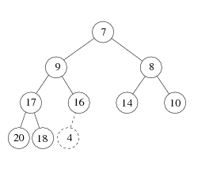
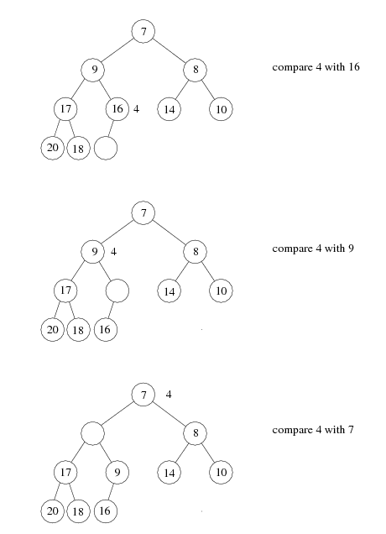

Insertion

Slide 11
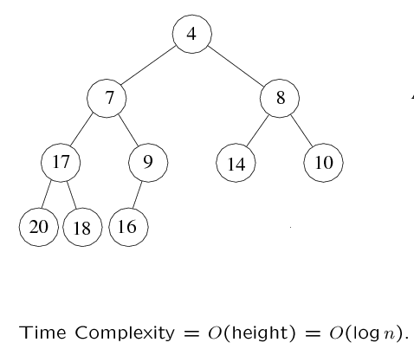
Insertion
A heap!

Slide 12
DeleteMin: first attempt
Delete the root.
Compare the two children of the root
Make the lesser of the two the root.
An empty spot is created.
Bring the lesser of the two children of the empty spot to the empty spot.
A new empty spot is created.
Continue

Slide 13
Deletion
2
Perform DeleteMin
6
8
6
8
9
7
11
9
7
11
6
6
7
5
8
9
11
9
7
11
Heap property is preserved, but completeness is not!

Slide 14
DeleteMin
Copy the last number to the root (i.e. overwrite the minimum element stored there)
Restore the min-heap property by “bubble down”

Slide 15
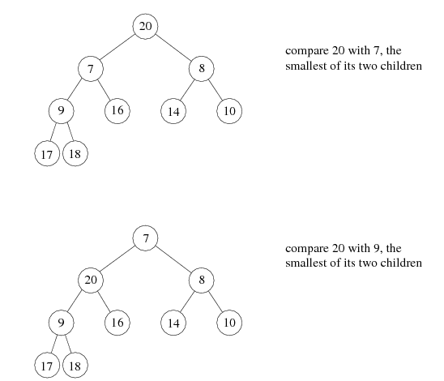

Slide 16
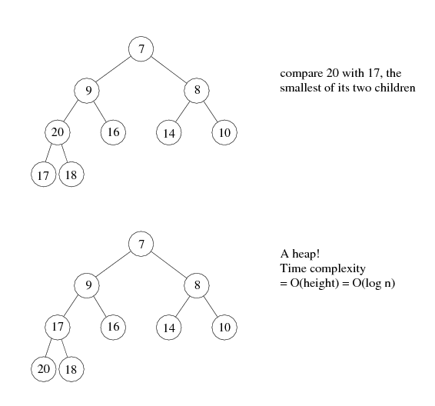

Slide 17

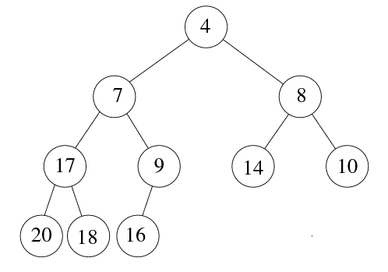
Heap: array implementation
1
2
3
5
6
7
4
8
9
10
Is it a good idea to store arbitrary binary trees as arrays? May have many empty spaces!

Slide 18
Array implementation
The root node is A[1].
The left child of A[j] is A[2j]
The right child of A[j] is A[2j + 1]
The parent of A[j] is A[j/2] (note: integer divide)
1
2
3
1
2
5
4
3
6
4
5
6
Need to estimate the maximum size of the heap.

Slide 19
Heapsort
(1) Build a binary heap of N elements
the minimum element is at the top of the heap
(2) Perform N DeleteMin operations
the elements are extracted in sorted order
(3) Record these elements in a second array and then copy the array back

Slide 20
Heapsort – running time analysis
(1) Build a binary heap of N elements
repeatedly insert N elements ⇒ O(N log N) time
(there is a more efficient way)
(2) Perform N DeleteMin operations
Each DeleteMin operation takes O(log N) ⇒ O(N log N)
(3) Record these elements in a second array and then copy the array back
O(N)
Total: O(N log N)
Storage: Uses an extra array

Slide 21
Heapsort: no extra storage
After each deleteMin, the size of heap shrinks by 1
We can use the last cell just freed up to store the element that was just deleted
⇒ after the last deleteMin, the array will contain the elements in decreasing sorted order
To sort the elements in the decreasing order, use a min heap
To sort the elements in the increasing order, use a max heap
the parent has a larger element than the child

Slide 22
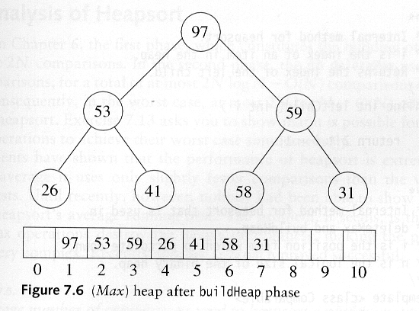
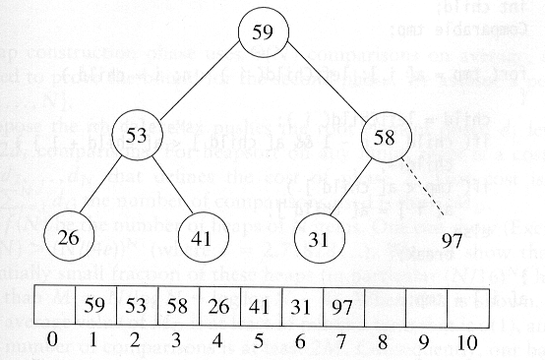
Heapsort
Sort in increasing order: use max heap
Delete 97

Slide 23
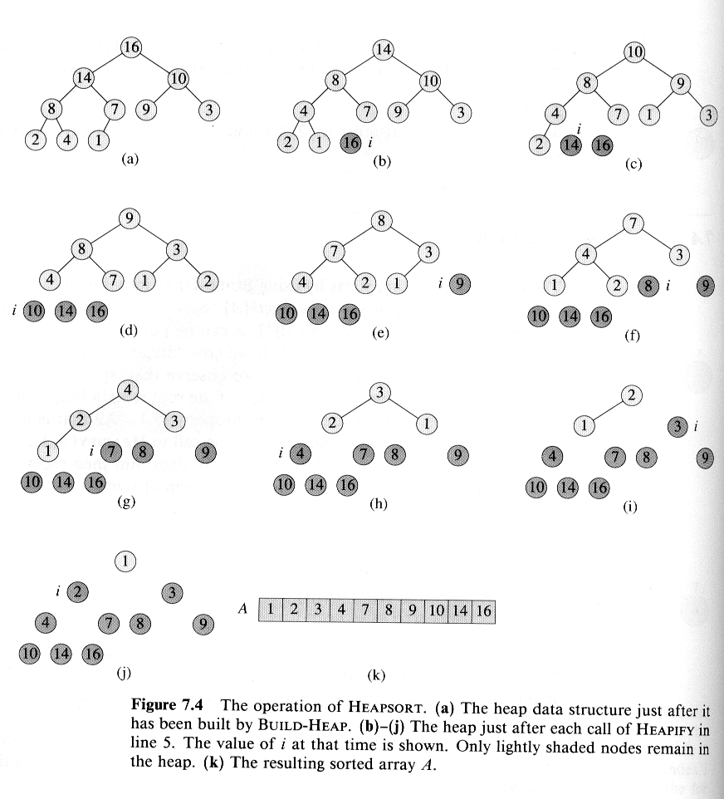
Heapsort: A complete example
Delete 16
Delete 14

Slide 24
Example (cont’d)
Delete 10
Delete 9
Delete 8

Slide 25
Example (cont’d)
Delete 7
Delete 4
Delete 3
Delete 2
Delete 1

Slide 26
End of Slides

